Slide 1
CARBON REMOVAL:
The What, the Why, and the How
Mark Preston
Eli Mitchell-Larson
Negative Emissions Platform:
Carbon Removal Summit
June 2023

Slide 2
Carbon Dioxide Removal:
What
Why
How

Slide 3
Carbon Dioxide Removal:
What
Why
How

Slide 4
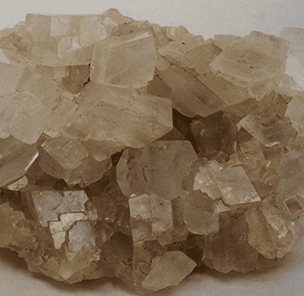
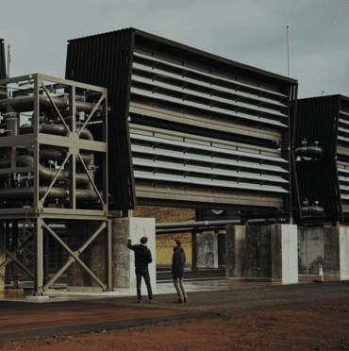
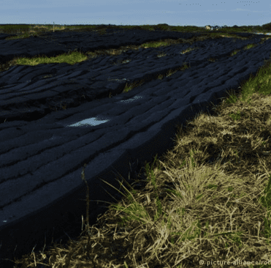
What is
Carbon Dioxide Removal?
CO₂
Mineralisation
Biomass CO₂
Removal &
Storage
Ocean Alkalinity Enhancement
“
Blue Carbon
Restoration
Forestation
Direct Air
Capture
Activities removing CO₂ from the atmosphere and durably store it in geological, terrestrial, or ocean reservoirs, or in products.
”
Bioliquid
Injection
Biochar
Soil Carbon
Sequestration
- IPCC, Working Group III
A vast array of Carbon Dioxide Removal solutions can be scaled up for impact.
Mineral Soil
Amendment
Frontier
CDR
Peat
Restoration

Slide 5
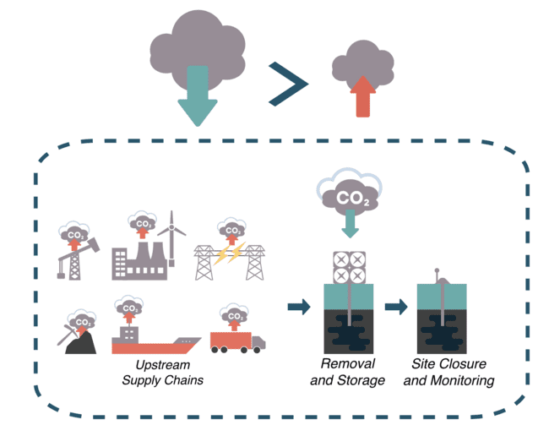
Principles for defining Carbon Dioxide Removal
CO₂ is physically extracted from the atmosphere.
The extracted atmospheric CO₂ is permanently stored.
All greenhouse gas emissions associated with the removal and storage processes are comprehensively estimated and included.
More atmospheric CO₂ is permanently stored than greenhouse gases are emitted in the removal and storage processes and their complete supply chains.
From: Tanzer et al (2019)
DOI: 10.1039/C8EE03338B
From: Tanzer et al (2019)
DOI: 10.1039/C8EE03338B

Slide 6
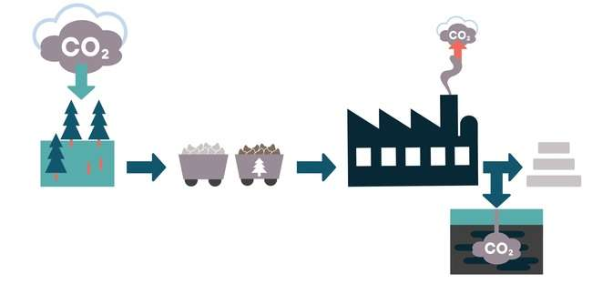
Source: Where does the CO₂ come from?
Forestation
Extraction by biomass
Storage in biomass.
Ongoing management.
CO₂ is physically extracted from the atmosphere.
Biomass + CCS
Extraction by biomass
Use by humans
Recapture by Chemicals
Storage in geology.
Direct Air Capture + Storage
Extraction by chemicals
Storage in geology.

Slide 7
Sink: Where is the CO₂ stored?
Forestation
Extraction by biomass
Storage in biomass.
Ongoing management.
CO₂ is physically extracted from the atmosphere.
The extracted atmospheric CO₂ is permanently stored.
Biomass + CCS
Extraction by biomass
Use by humans
Recapture by Chemicals
Storage in geology.
Direct Air Capture + Storage
Extraction by chemicals
Storage in geology.

Slide 8
System: What happens between source and sink?
CO₂ is physically extracted from the atmosphere.
The extracted atmospheric CO₂ is permanently stored.
All greenhouse gas emissions associated with the removal and storage processes are comprehensively estimated and included.

Slide 9
System: What happens between source and sink?
CO₂ is physically extracted from the atmosphere.
The extracted atmospheric CO₂ is permanently stored.
All greenhouse gas emissions associated with the removal and storage processes are comprehensively estimated and included.
More atmospheric CO₂ is permanently stored than greenhouse gases are emitted in the removal and storage processes and their complete supply chains.
From: Tanzer et al (2019)
DOI: 10.1039/C8EE03338B
From: Tanzer et al (2019)
DOI: 10.1039/C8EE03338B

Slide 10
What is (not) CDR?
Emissions
Emission Reduction
Removal
CO₂
CO₂
_{Atmosphere}
_{Atmosphere}
_{Atmosphere}
Principle 2 ✗
Principle 1 ✓
Biomass
CCS
Bio-CCS
CCU fuel use
Principle 1 ✗
Principle 1 ✗
Principle 2 ✓
Principle 2 ✓
Stored carbon is extracted
_{Permanent geological storage}
Permanent geological storage
_{Permanent geological storage}
Stored carbon is extracted
CO₂ Stored
CO₂ Stored
Emissions Avoidance is not, and never can be Carbon Dioxide Removal

Slide 11
CO₂
Mineralization
Biomass CO₂
Removal &
Storage
Ocean Alkalinity Enhancement
Atmospheric
carbon
CCS: Carbon
capture and
storage
CCU
Blue Carbon
Restoration
Forestation
Direct Air
Capture
Short-term
storage
Carbon
Products
(including
fuels)
CDR
CCU: Carbon
capture and
utilization
Bioliquid
Injection
Biochar
Soil Carbon
Sequestration
CO
Long-term
storage
2
emissions
CCS
Fossil
carbon
Carbon
Sinks
Long-term storage
Mineral Soil
Amendment
Frontier
CDR
Peat
Restoration

Slide 12
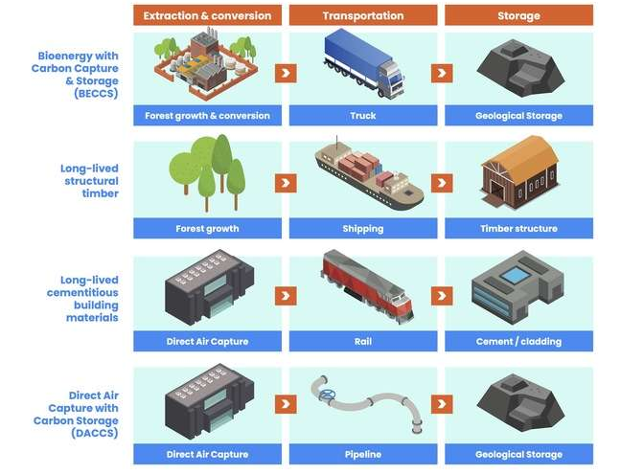
Modularity of CDR methods

Slide 13
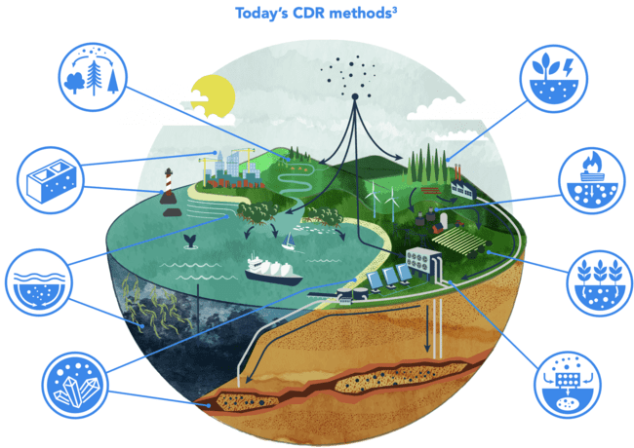
Illustration by Walker Cahall - www.waltronic.net

Slide 14
Are permanence and durability the same?
Permanence is an ideal reference case in which stored carbon remains stored in perpetuity
Durability is a physical characteristic of stored carbon, indicating risk of physical reversal
Expected residence time is how long we expect carbon to remain stored, on average

Slide 15
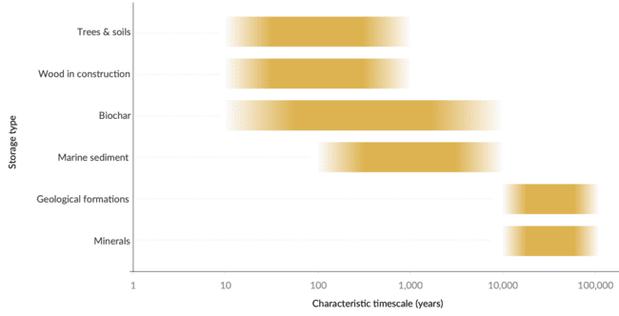
Are permanence and durability the same?
Permanence is an ideal reference case in which stored carbon remains stored in perpetuity
Durability is a physical characteristic of stored carbon, indicating risk of physical reversal
Expected residence time is how long we expect carbon to remain stored, on average
State of CDR report, IPCC

Slide 16
Carbon Dioxide Removal:
What
Why
How

Slide 17
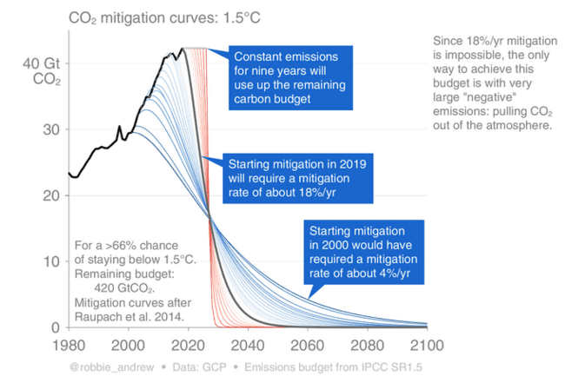
Emission reductions are falling short
Action to cut emissions has been slow
The slower we cut emissions, the more our dependence of removals increases

Slide 18
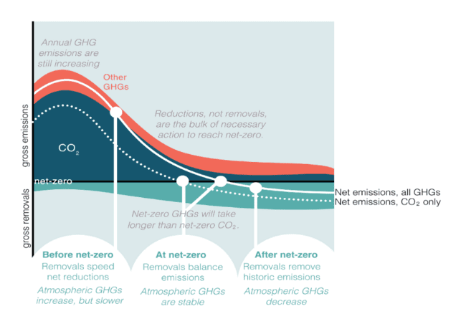
Carbon Dioxide Removal is unavoidable
To accelerate climate action
To balance out residual GHG emissions
To reduce global CO2 concentrations
NB: Carbon neutrality =/= Climate neutrality
Climate neutrality by 2050 means carbon neutral before 2050

Slide 19
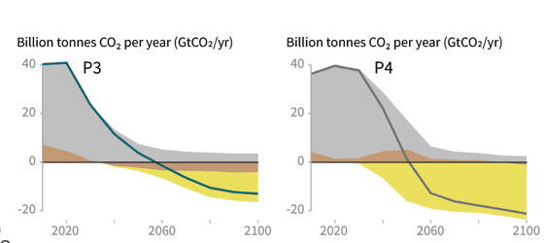
IPCC scenarios gravitate towards CDR
Cost optimization models with imperfect assumptions
BECCS serves as a proxy for CDR more generally
IPCC scenarios do not include some real-life constraints (e.g., limit to biomass supply)
IPCC SR15

Slide 20
Carbon Dioxide Removal is unavoidable
To accelerate climate action
To balance out residual GHG emissions
To reduce global CO2 concentrations
NB: Carbon neutrality =/= Climate neutrality

Slide 21
Carbon Dioxide Removal:
What
Why
How

Slide 22
How can we use carbon removal?
Negative carbon flux – A flow of CO2 from atmosphere into a carbon stock
Carbon removal – The portion of the negative flux that is attributed to human action, secured for long-term storage, and net of associated emissions
Climate benefit – The portion of the carbon removal that is claimed to

Slide 23
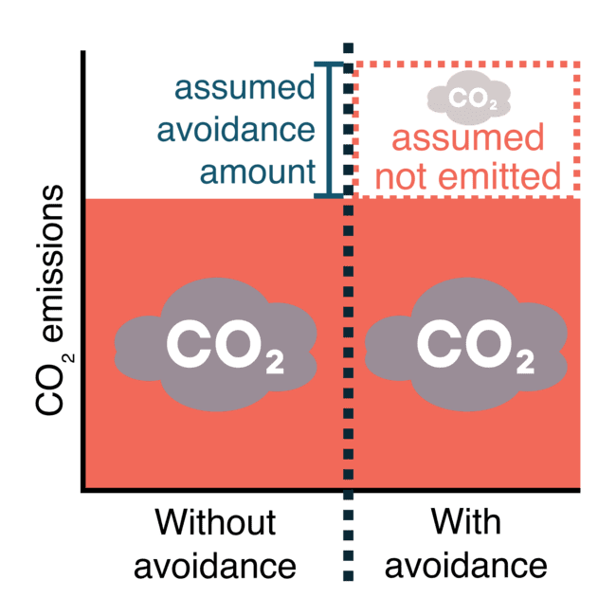
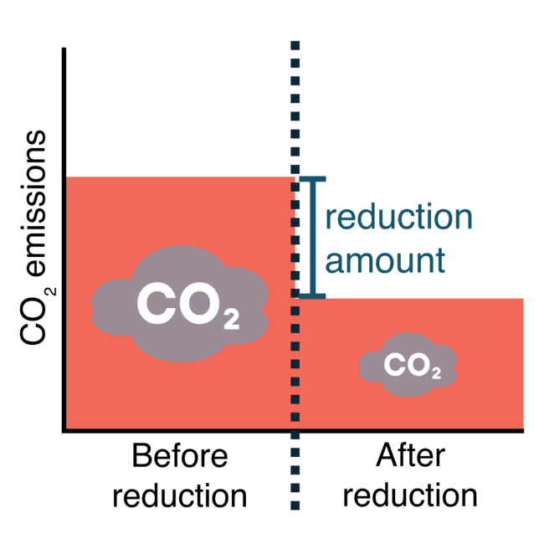
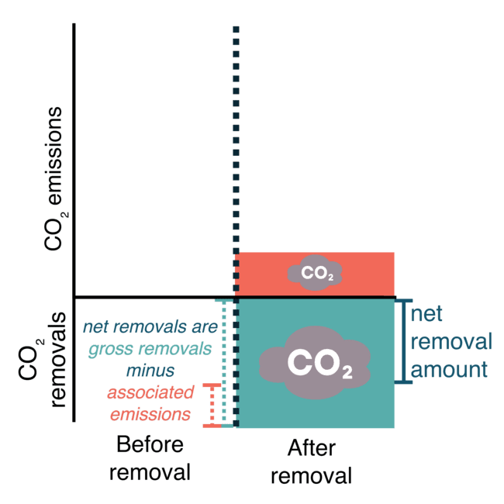
CO₂ Avoidance:
measures an assumption in
t CO₂ assumed to be avoided
CO₂ Reduction:
measures a change in
t CO₂ less than before
CO₂ Removal:
measures a physical flow in
t CO₂ removed from the atmsophere
(net of associated emissions)

Slide 24
CO₂ Avoidance:
measures a “non-emission”
CO₂ Reduction:
measures a “non-emission”
CO₂ Removal:
measures a physical flow

Slide 25
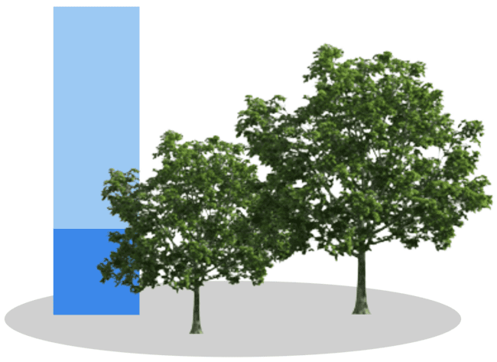
Claiming a climate benefit
Contribution claim
(positive action)
Compensation claim
("neutralization")
"My € contribution directly caused this climate benefit"
"I bought carbon credits, which I claim compensate for some of my emissions"
Removed carbon
Baseline carbon
Compensation claims come with challenges:
Climate damages are non-linear and diverse, cannot be fully "neutralized"
It matters which emissions are being compensated for
Are the emissions "difficult to decarbonize"?
It matters which removals are being used to claim compensation

Slide 26
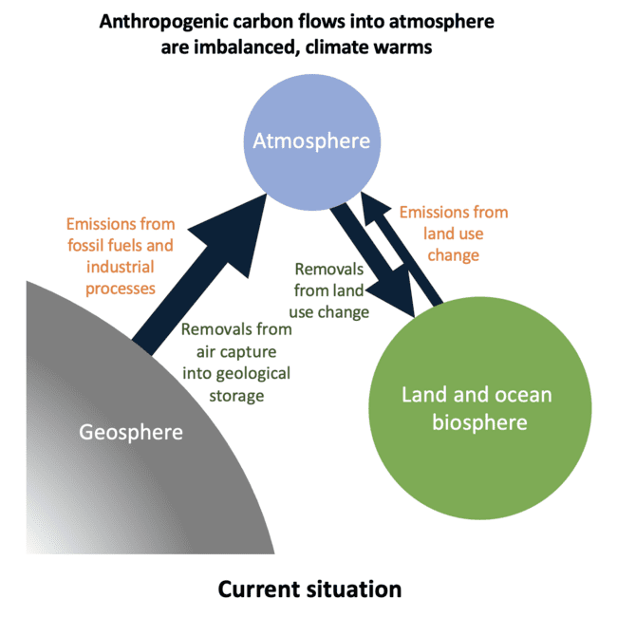
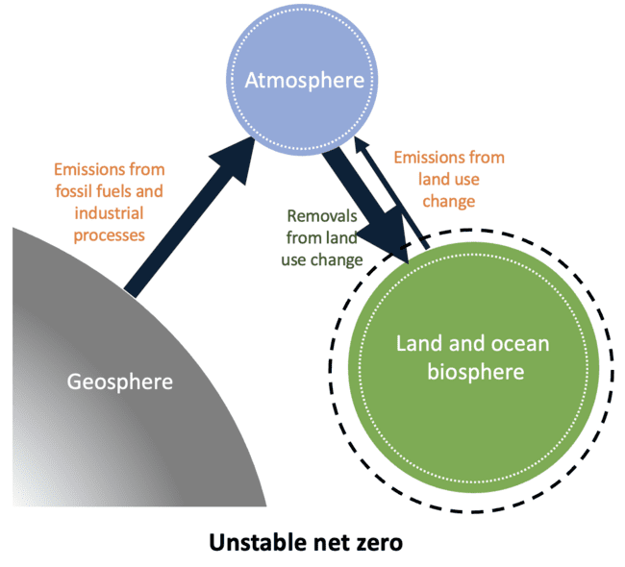
Not all "net zero's" are the same
Today – Carbon flows out of balance, climate warms
Unstable net zero – Emissions balanced temporarily
WEF, Fankhauser et al. 2022

Slide 27
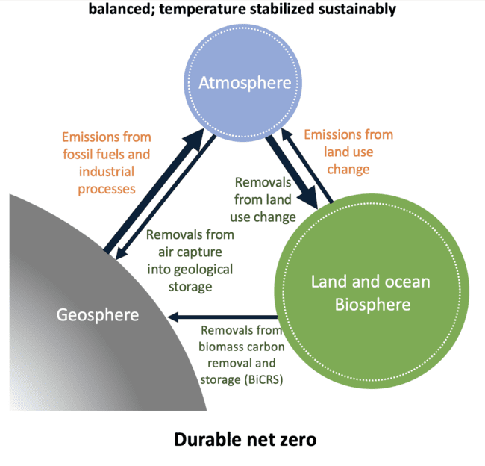
Not all "net zero's" are the same
Today – Carbon flows out of balance, climate warms
Durable net zero – Flows to and from biosphere & geosphere balanced
WEF, Fankhauser et al. 2022

Slide 28
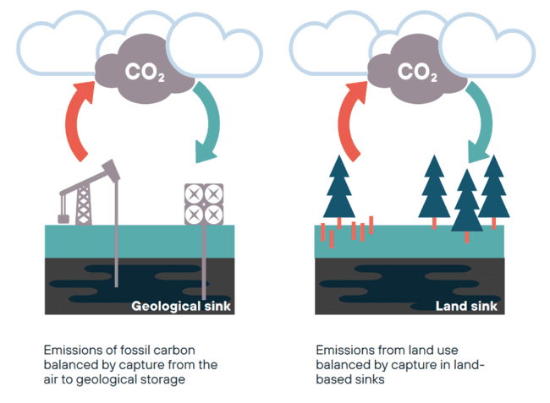
Manage the biosphere and geosphere separately
Carbon from the geosphere must go back into the geosphere
Carbon from the biosphere must go back into the biosphere

Slide 29
How should we regulate Carbon Dioxide Removal?
Establish ambitious emission reduction targets
Set up additional & separate target for CDR
Manage the land and geological sinks separately
Regulate and clarify net-zero claims

Slide 30
CDR optimism
CDR concerns
Let’s build a healthy middle ground
We agree emission cuts are the priority
We agree we need some CDR
We agree both must happen in parallel
Let’s build a policy framework which benefits the climate
Separate targets for reductions & removals
Defining what is "hard-to-decarbonize"
Proactively tackling mitigation deterrence
Restoring ecosystems for their own sake

Slide 31
THANK
YOU
Mark Preston
Bellona Foundation
mark@bellona.org
Eli Mitchell-Larson
Carbon Gap
eli@carbongap.org

